Slide 1
Tasty Bites
Leveraging Data to Drive User Engagement
By Alham Omar Hotaki
September 2023

Slide 2
Overview
Tasty Bytes was founded in 2020 in the midst of the Covid Pandemic. The world wanted inspiration so we decided to provide it. We started life as a search engine for recipes, helping people to find ways to use up the limited supplies they had at home.
Now, over two years on, we are a fully fledged business. For a monthly subscription we will put together a full meal plan to ensure you and your family are getting a healthy, balanced diet whatever your budget. Subscribe to our premium plan and we will also deliver the ingredients to your door.

Slide 3
The Problem
At the moment, Product Manager choose a favorite recipe from a selection and display that on the home page. It has been noticed that traffic to the rest of the website goes up by as much as 40% if he picks a popular recipe. But he doesn’t know how to decide if a recipe will be popular. More traffic means more subscriptions so this is really important to the company.
What is required?
- Predict which recipes will lead to high traffic?
- Correctly predict high traffic recipes 80% of the time?

Slide 4
Project objective:
Predict which recipes will lead to high traffic 80% of the time and minimize the chance of showing unpopular recipes to users.

Slide 5
Business Goals
1
2
Enhance user engagement by showcasing high-traffic recipes.
Optimize content strategy by understanding user preferences and behaviors.

Slide 6
The Data

Slide 7
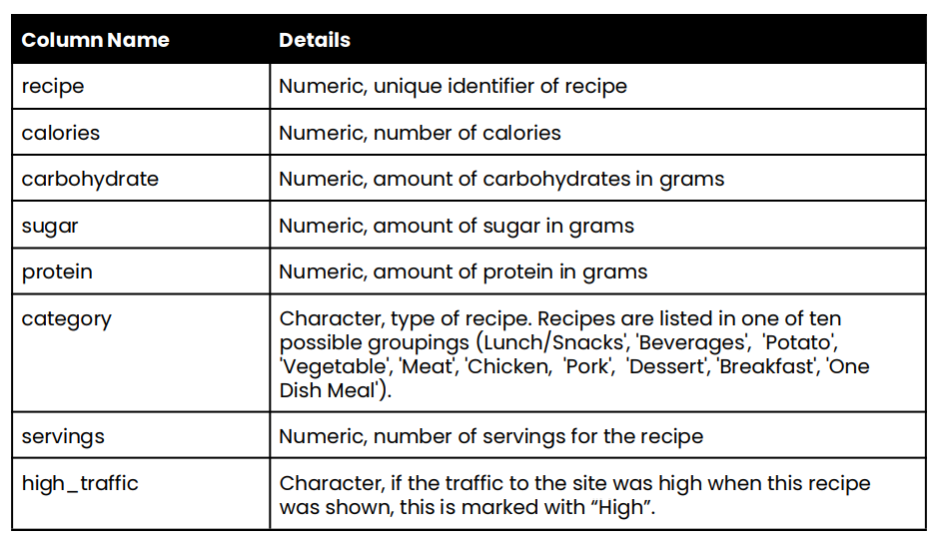
The Data - Structure

Slide 8
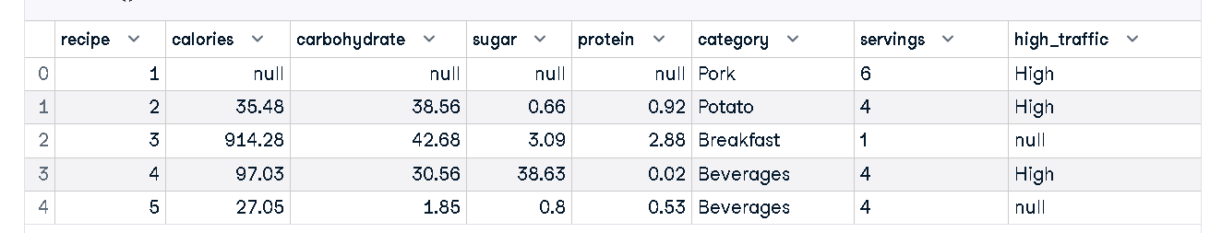
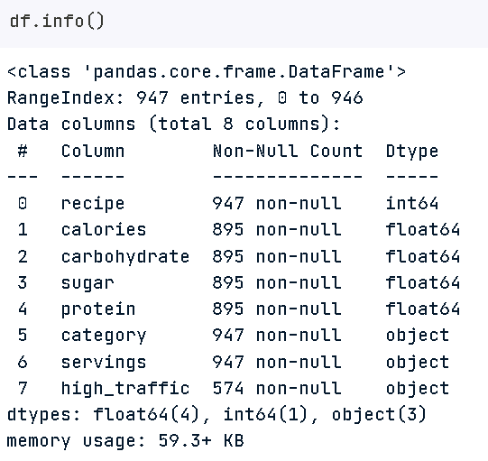
The Data - a snippet of the Dataset

Slide 9
Data Validation and Cleaning

Slide 10
Data Validation
Data validation was crucial to ensure the reliability and accuracy of our dataset. During this phase, we closely examined the dataset to identify any inconsistencies, inaccuracies, or anomalies that could affect the analysis. The dataset was scrutinized for:
Data Types: We ensured that the data types of each feature were appropriate, converting them as necessary. For example, the servings feature was converted to numeric.
Unique Categories: We examined categorical variables and consolidated similar categories, like merging 'Chicken Breast' into 'Chicken'.
Missing Values: We assessed the extent of missing values in the dataset to decide on the subsequent cleaning steps.

Slide 11
Data Cleaning
Once the validation phase highlighted the areas needing attention, we embarked on a meticulous data cleaning process to refine the dataset. The data cleaning comprised the following steps:
Handling Missing Values: We dropped rows with missing values in essential features like calories, sugar, and protein to maintain the integrity of our analysis.
Category Consolidation: We consolidated similar categories to avoid redundancy and ensure uniformity, notably changing 'Chicken Breast' to 'Chicken' under the category feature.
Servings Adjustment: We transformed the servings feature by extracting numeric values and converting them to the appropriate data type.
Filling NaN Values: We treated NaN values judiciously, filling missing values in the 'high_traffic' feature with 'Low' to maintain dataset consistency.

Slide 12
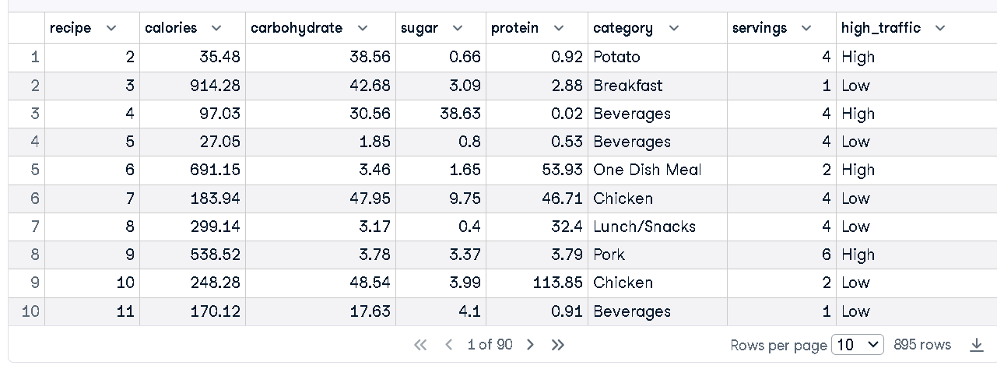
A snippet of Dataset - after validation and cleaning

Slide 13
Exploratory Data Analysis

Slide 14
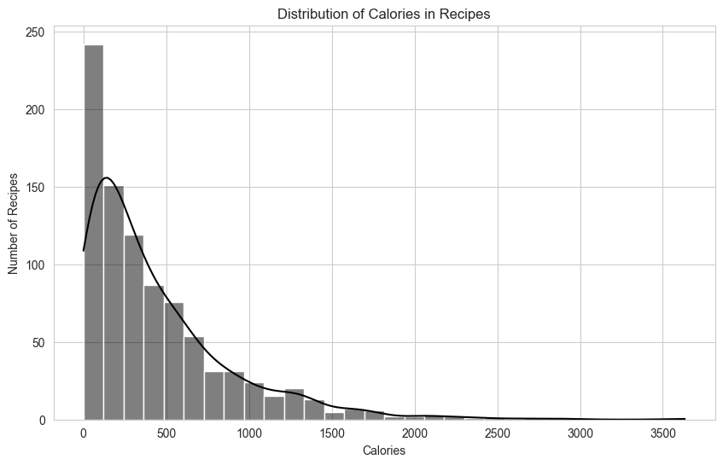
EDA Insights (1)
Analyzed distribution of various features like calories, carbohydrates, and protein.
Investigated category-wise traffic and servings.
Around 10 visuals better describe the outcomes of EDA.

Slide 15
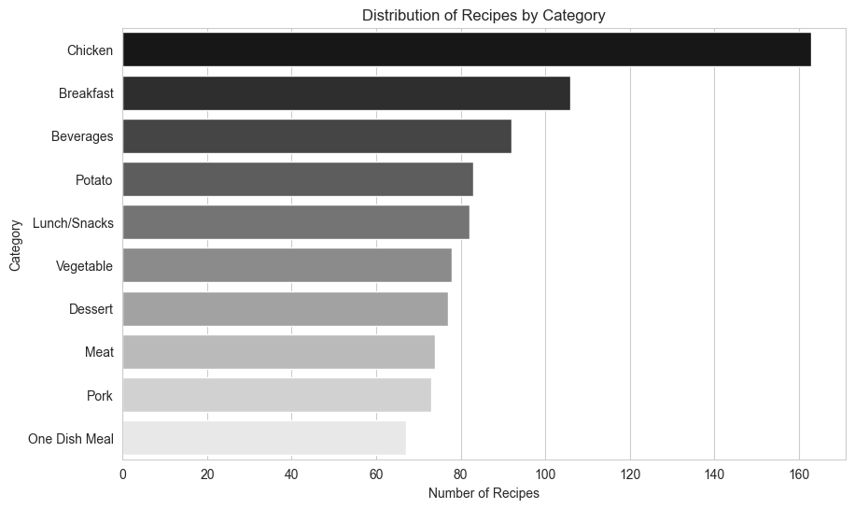
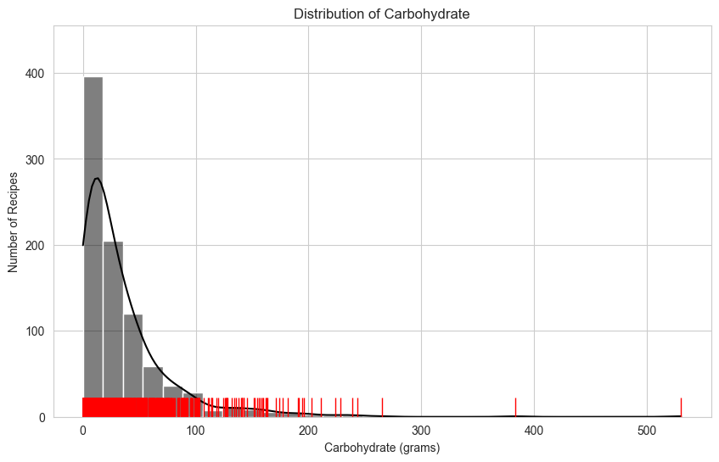
EDA Insights (2)

Slide 16
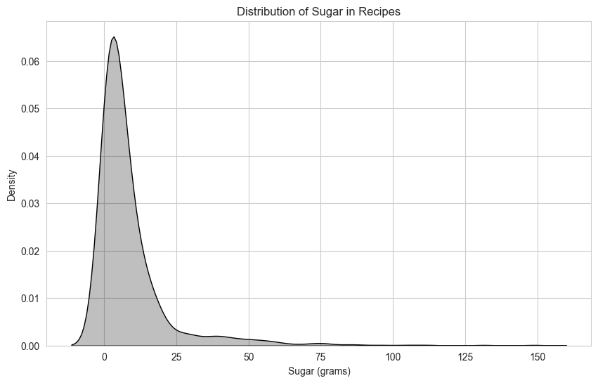
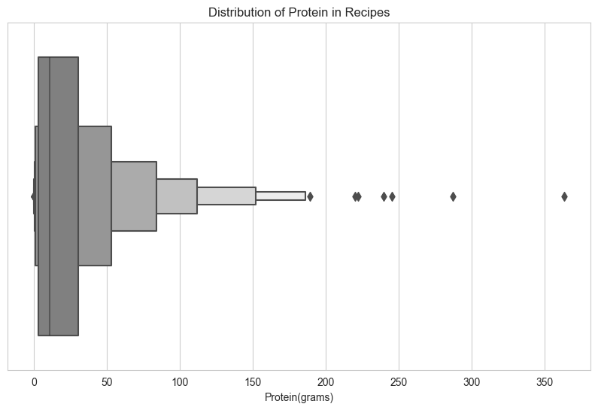
EDA Insights (3)

Slide 17
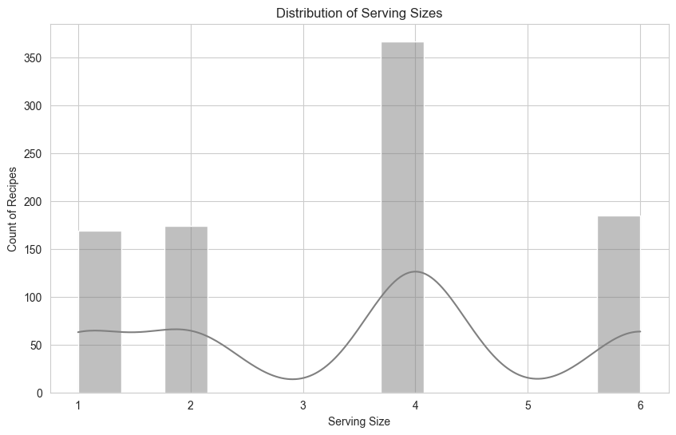
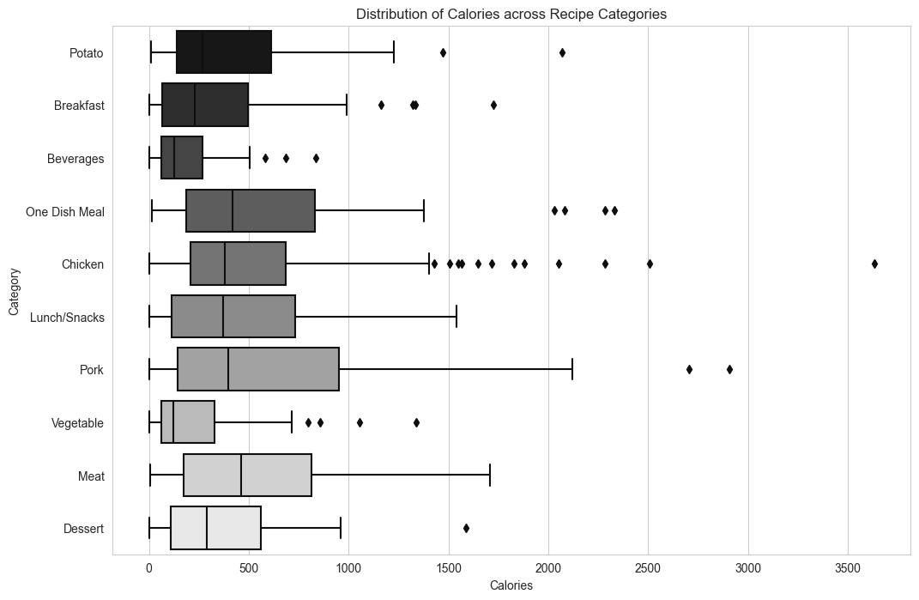
EDA Insights (4)

Slide 18
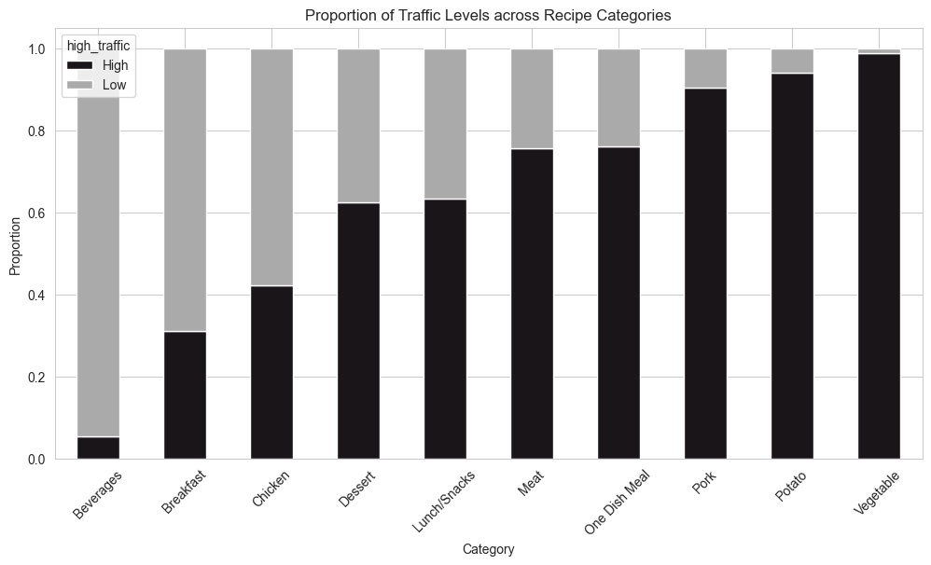
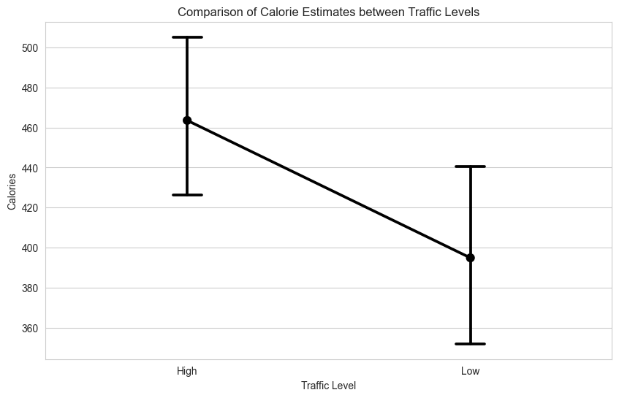
EDA Insights (5)

Slide 19
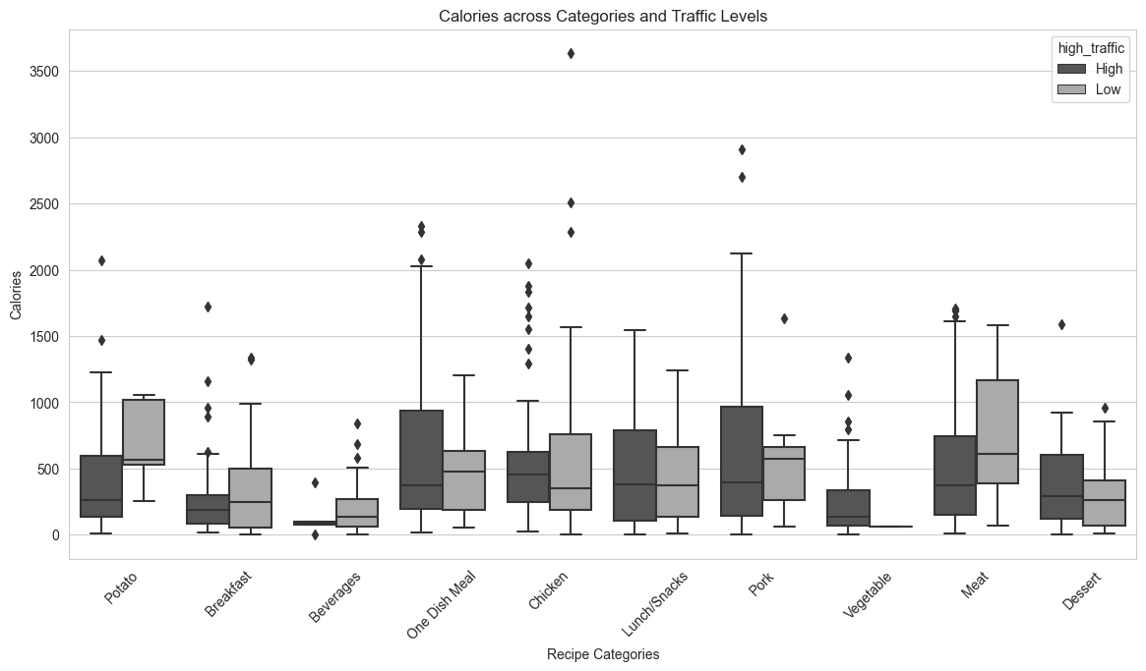
EDA Insights (6)

Slide 20
EDA Findings Summary
The EDA findings unveil a multi-faceted landscape of user preferences and recipe characteristics.
Most recipes are marked by lower to moderate calorie content, with a user preference leaning towards healthier, lighter options, predominantly in the “Chicken,” “Breakfast,” and “Beverages” categories.
Carbohydrate, sugar, and protein contents are generally lower, aligning with the prevailing low-calorie trend, suggesting a health-conscious user base.
Most recipes have calories ranging from 0 to 1000, with the majority between 0 and 200 calories.
"Chicken" is the most common category, leading in traffic, followed by "Breakfast" and "Beverages".
High traffic is generally correlated with higher calorie content in recipes.
The serving sizes predominantly cater to family settings, with a median of 4 servings. However, the varied distribution in protein and the presence of high-calorie outliers across categories hint at a diverse user base with niche interests.

Slide 21
Model Development

Slide 22
Baseline and Comparison Models
Problem Type:
The task is to predict whether a recipe will lead to high traffic. This is a binary classification problem since each recipe can either belong to the "High" traffic category or "Low" traffic category.
Baseline Model:
A Logistic Regression model served as the baseline model, providing initial insights and a reference point for model comparison has been developed based on the available data.
Comparison Model:
A Random Forest Classifier was developed as a comparison model to capture more complex relationships in the data and improve prediction accuracy.

Slide 23
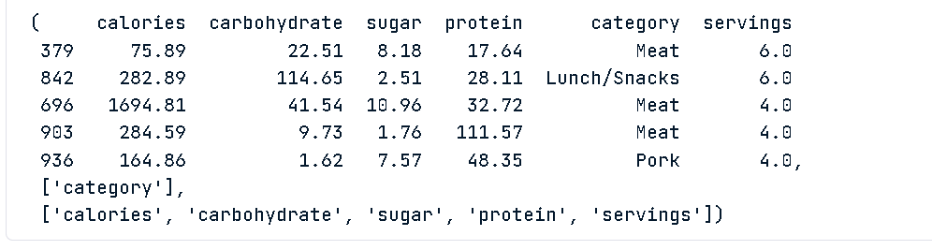
Preprocessing the Data
We have successfully preprocessed the data: The categorical column identified is category. The numerical columns identified are calories, carbohydrate, sugar, protein, and servings. The data has been split into training and testing sets. We have created preprocessing pipelines for both numerical and categorical data

Slide 24
Baseline Model - Logistic Regression Model
The baseline model, Logistic Regression, has been trained and evaluated. Here are the evaluation metrics for the baseline model on the test set:
Accuracy: 76.54%
Precision: 79.82%
Recall: 81.31%
F1 Score: 80.56%
AUC-ROC: 75.38%
Precision is particularly important for this task as we want to correctly predict high traffic recipes 80% of the time. The baseline model has a precision of approximately 79.82%, which is close to the desired 80%.

Slide 25
Comparison Model - Random Forest Classifier
The comparison model, a Random Forest Classifier, has been trained and evaluated. Here are the evaluation metrics for the comparison model on the test set:
Accuracy: 73.74%
Precision: 76.32%
Recall: 81.31%
F1 Score: 78.73%
AUC-ROC: 71.90%

Slide 26
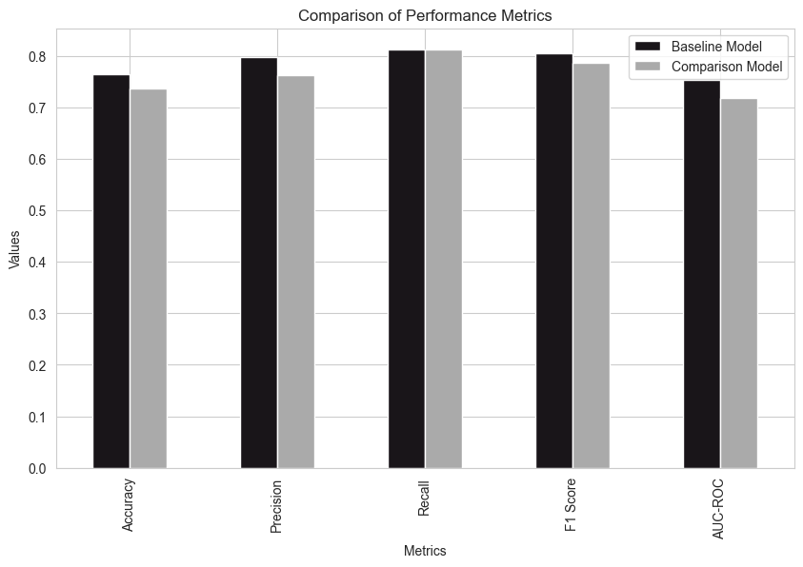
Comparison and Evaluation of Models
The Baseline Model (Logistic Regression) performed slightly better in terms of precision, accuracy, F1 Score, and AUC-ROC compared to the Random Forest Classifier, even though the recall was the same for both models.
Precision is crucial for this task, and the Logistic Regression model achieved a precision of 79.82%, which is close to the desired 80%.

Slide 27
Business Metrics

Slide 28
Business Metrics
To define a business metric to monitor, it’s crucial to align the metric with the business goals and objectives. In this case, the business wants to predict which recipes will be popular 80% of the time and minimize the chance of showing unpopular recipes. Based on this, the business can monitor a set of related metrics that can provide insights into the achievement of this goal.
1. Conversion Rate: The percentage of users who interact with a promoted recipe and generate high traffic.
2. Engagement Rate: The level of interaction users have with the promoted recipes.
3. User Retention Rate: The percentage of users who continue to interact with the website over a given period.
4. Average Session Duration: The average amount of time a user spends interacting with the website during a session.

Slide 29
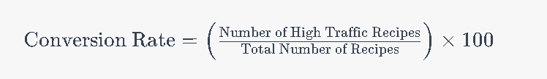
Conversion Rate
Based on the current data, the initial value for this metric can be calculated. Conversion Rate is The percentage of users who interact with a promoted recipe and generate high traffic. In order to monitor this rate, regularly calculate by dividing the number of high-traffic recipes by the total number of promoted recipes over a specific period. Based on the current data, the initial Conversion Rate can be estimated as the proportion of recipes with high traffic.

Slide 30
Conversion Rate
Current Conversion Rate: The current conversion rate is approx 60%. In order to increase the rate, the following mechanism should be in place.
Daily Monitoring: Monitor the Conversion Rate daily through the dashboards to identify any sudden changes or trends.
Analysis and Insights: Analyze the conversion data to identify high-performing and underperforming recipes and derive insights into user preferences.
Strategy Adjustment: Use the insights from the conversion data to adjust the promotion strategies for different recipes.

Slide 31
Summary and Recommendations

Slide 32
1. User-Centric Content Development
Health-Conscious Alignment: Develop and prominently feature recipes that align with the predominant health-conscious trend, focusing on lower calories, carbohydrates, and sugar content to cater to the majority user preference.
Dietary Diversity: Ensure a balanced and diverse recipe portfolio that includes varied dietary preferences like high-protein, vegetarian, and indulgent recipes to address the diverse needs of the user base.

Slide 33
2. Strategic Promotion and Visibility
Popular Categories Focus: Amplify the promotion and visibility of recipes in popular categories like "Chicken," "Breakfast," and "Beverages," leveraging their inherent user appeal to drive engagement and traffic.
Niche Exploration: Innovate within underrepresented and high-calorie outlier categories to explore niche interests and enhance user engagement by offering unique and varied content.

Slide 34
3. Data-Driven Adaptation
User Interaction Monitoring: Implement robust data collection and analytics to continuously monitor user interactions, preferences, and feedback, adjusting content and promotional strategies in real-time to align with evolving user needs and trends.
Performance Analysis: Regularly review the performance of recipes against business metrics, utilizing insights to optimize content, tailor promotional strategies, and enhance the overall user experience.

Slide 35
4. Further Analysis and Enhancement
Model Development: Explore additional models like Decision Trees, SVM, and Neural Networks for improved predictive accuracy.
User Feedback Integration: Actively seek and integrate user feedback to refine recipe content and presentation, ensuring a more personalized and user-friendly experience.
A/B Testing and Validation: Employ A/B testing and other validation strategies to assess the effectiveness of content and promotional modifications, ensuring informed and impactful decision-making.

